Slide 1

Exploring the Impact of Hyperparameter Variation on Single-Cell Annotation: Unveiling Insights into Cell Type Identification

Slide 2
Outline
Central Dogma of Molecular Biology
Single Cell Segmentation
Description of Data
Standard Scanpy Workflow
My Task
Methodology
Results
Future Goals

Slide 3
Central Dogma of Molecular Biology
Definition: The fundamental process governing the flow of genetic information within a biological system.
Components: DNA replication, transcription, and translation.
Importance: Understanding molecular mechanisms underlying cellular processes.
Notes:
The Central Dogma of molecular biology outlines the fundamental processes governing genetic information flow in living organisms: DNA replication, transcription, and translation. This concept is crucial for understanding how genetic information is copied, transcribed into RNA, and translated into proteins, elucidating the molecular mechanisms underlying cellular functions.

Slide 4
Single Cell Segmentation
Definition: Single-cell segmentation entails the identification and delineation of individual cells within a biological sample.
Techniques: This process primarily utilizes image analysis algorithms to segment cells based on features such as morphology.
Applications: Single-cell segmentation is essential for tasks like single-cell RNA sequencing (scRNA-seq) and cellular morphology studies, enabling precise analysis of cellular composition and characteristics within biological samples.
Notes:
In the context of our project using Scanpy, single-cell segmentation refers to the computational process of identifying distinct cell populations within our dataset. Unlike traditional segmentation methods based on cellular characteristics like intensity and shape, Scanpy employs advanced algorithms for clustering cells based on their gene expression profiles. By analyzing the unique patterns of gene expression in each cell, Scanpy enables us to classify cells into different groups or clusters, allowing for a deeper understanding of cellular diversity and function in our biological samples.

Slide 5
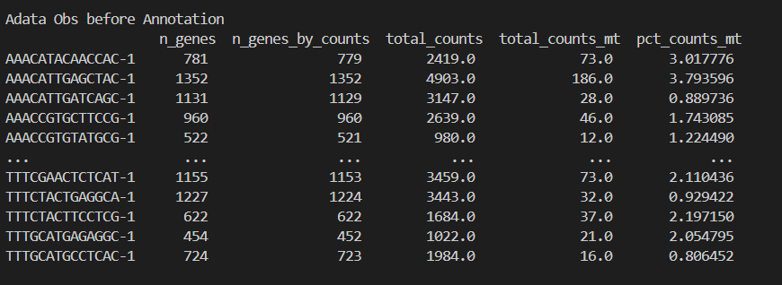
Description of Data
Data Source: 10x Genomics' single-cell
RNA sequencing data.
Characteristic: filtered gene-barcode matrices, single-cell RNA sequencing experiments on peripheral blood mononuclear cells (PBMCs)
Num of Cells: 2700
Mean Reads per Cell: 68,881
Median Genes per Cell: 817

Slide 6
Standard Scanpy Workflow
Overview: Step-by-step analysis pipeline for single-cell data using Scanpy.
Components: Preprocessing, dimensionality reduction (Principal Component Analysis), clustering (e.g., Leiden), marker gene identification for a specific number of PCA and number of neighbours.
Notes:
Explain yourself

Slide 7
My Task
Annotate single-cell data to identify distinct cell types
Explore the impact of altering hyperparameters on annotation outcomes
Analyse parameter selection's influence on the quality and accuracy of cell type identification
Notes:
Explain yourself

Slide 8
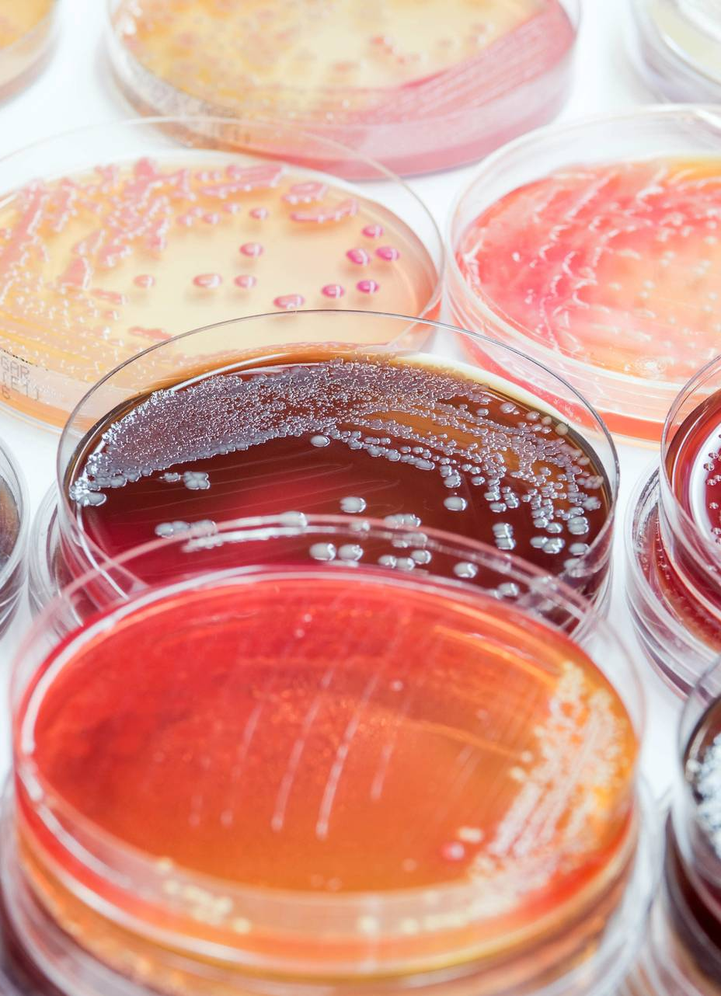
Methodology

Slide 9
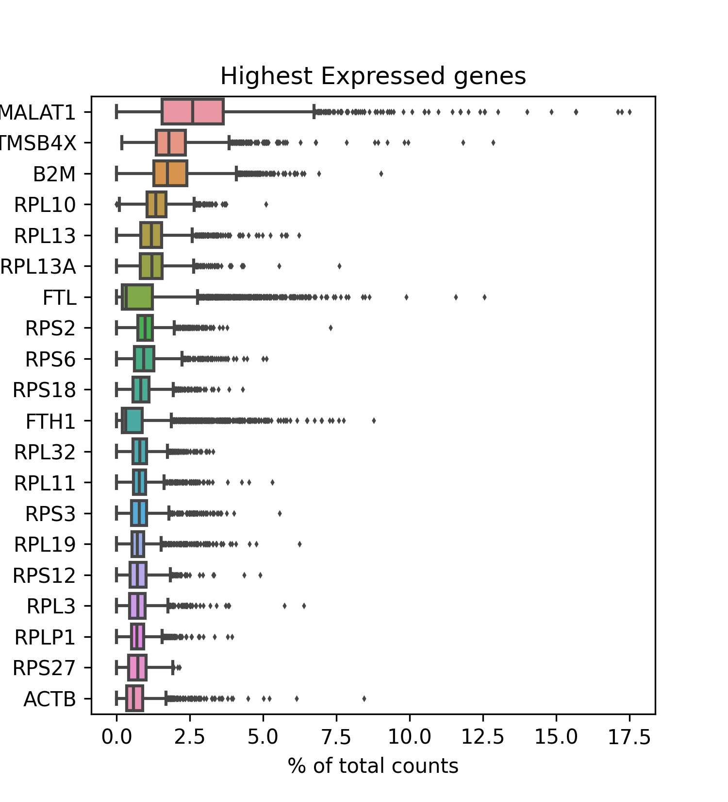
Data Acquisition and Preprocessing
Downloaded and extracted single-cell RNA sequencing data from 10x Genomics automatically.
Preprocessed the data to filter out low-quality cells and genes, performed quality control, and normalized gene expression
Notes:
The image "Highest Expressed Genes" illustrates the genes with the most significant expression levels across individual cells in the dataset, providing insights into the molecular characteristics and potential functional roles of these highly expressed genes within the cellular population.

Slide 10
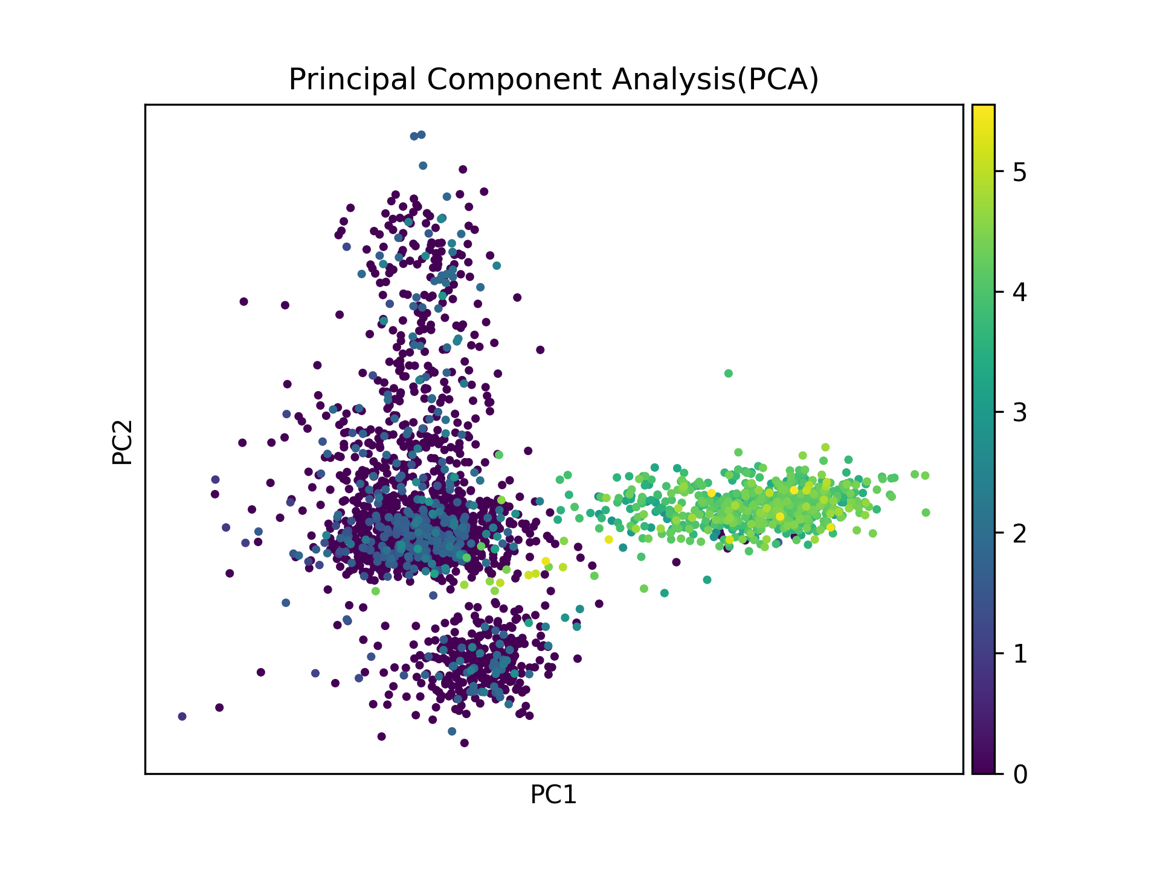
Dimensionality Reduction with PCA
Implemented Principal Component Analysis (PCA) to reduce the high-dimensional gene expression data.
Visualized the PCA results to understand the underlying structure of the dataset.

Slide 11
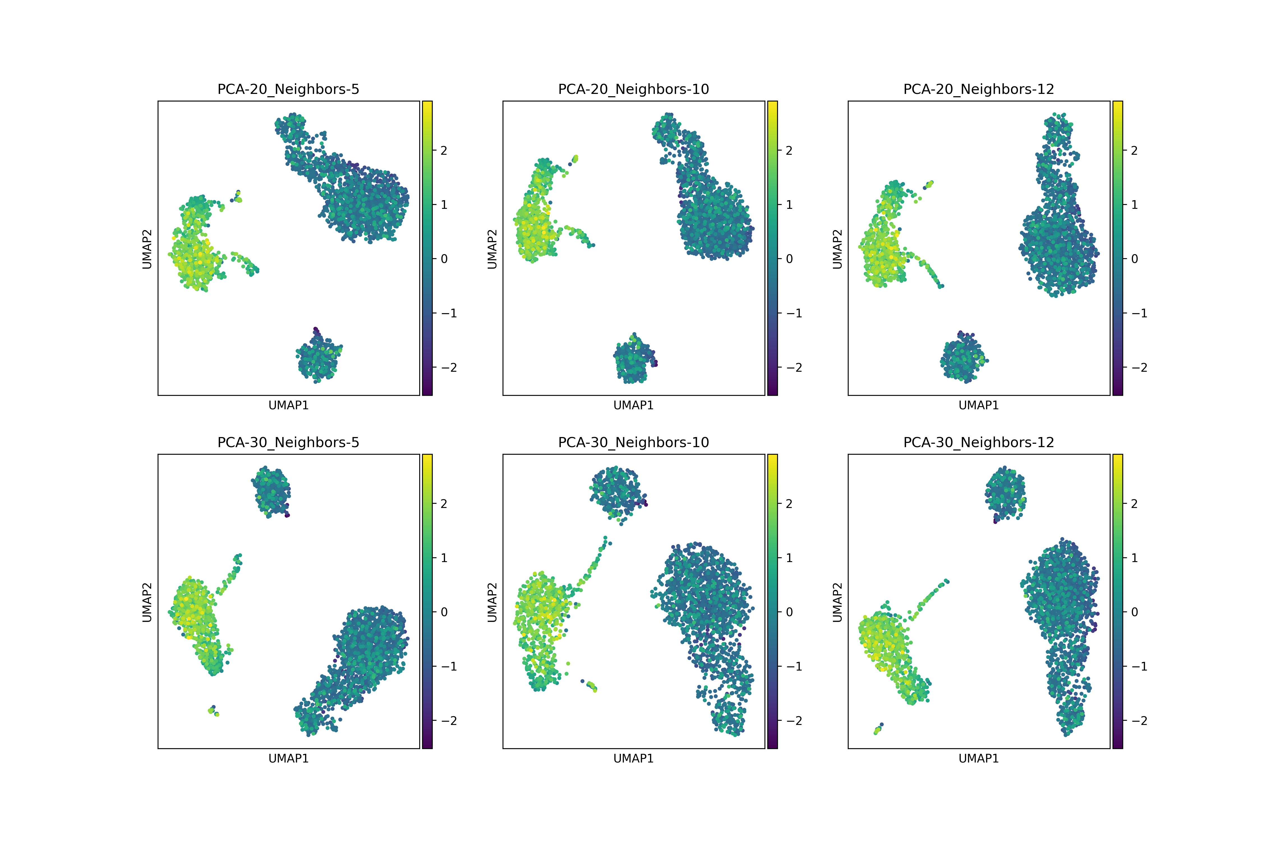
Computing and Embedding Neighbourhood Graph
Utilized Scanpy to compute and embed a neighbourhood graph for the cells based on their gene expression profiles.
Visualized the neighbourhood relationships using Uniform Manifold Approximation and Projection (UMAP) for each combination of PCA and Number of neighbours.

Slide 12
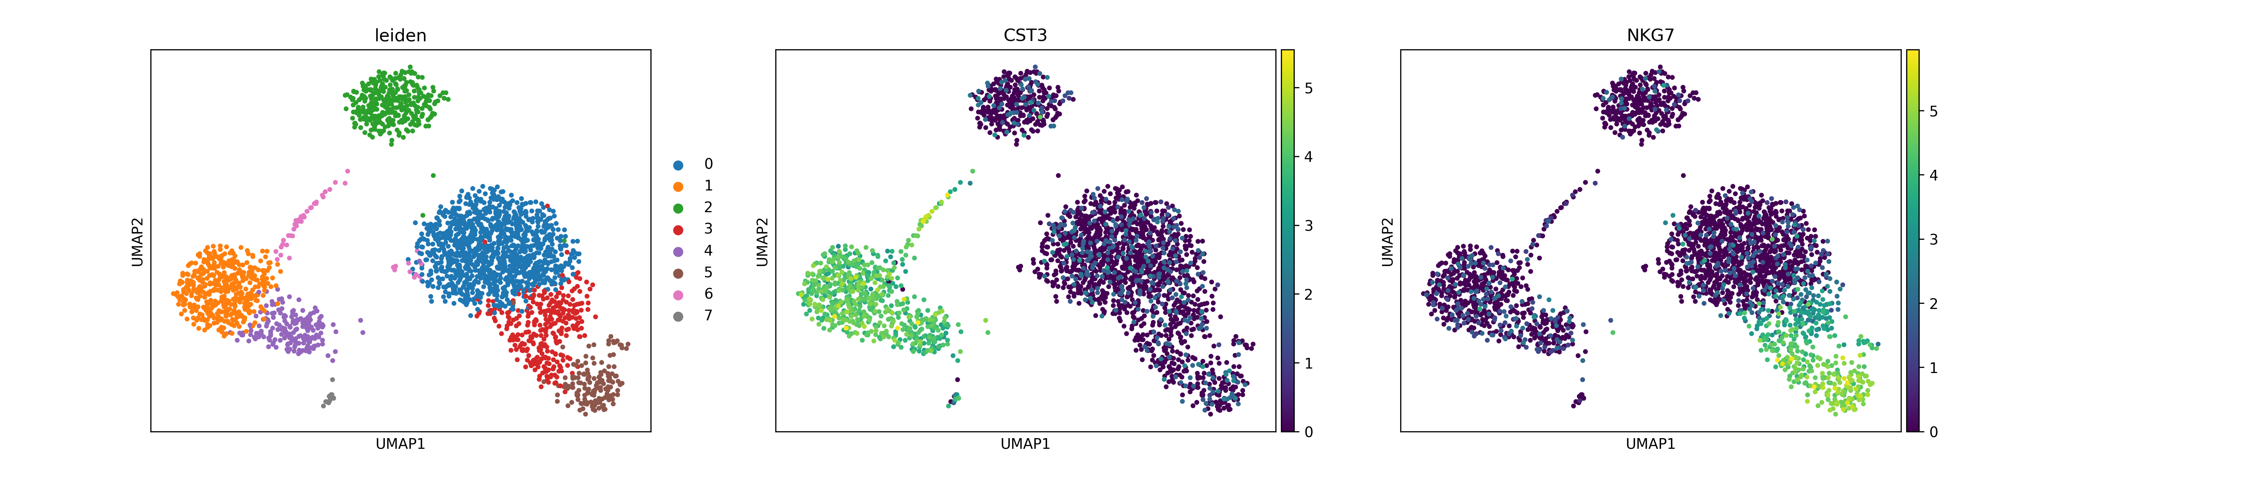
Cluster Identification and Marker Gene Detection
Identified cell clusters using the Leiden algorithm on the computed neighbourhood graph.
Detected marker genes associated with each cell cluster to characterize distinct cell types.

Slide 13
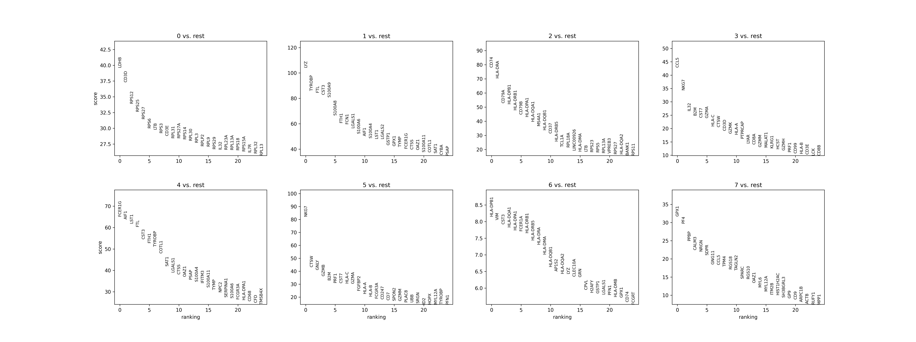
Cluster Identification and Marker Gene Detection
Identified cell clusters using the Leiden algorithm on the computed neighbourhood graph.
Detected marker genes associated with each cell cluster to characterize distinct cell types.
Notes:
Marker genes serve as distinctive molecular signatures that allow for the precise identification and classification of different cell types within complex populations, facilitating the understanding of cellular heterogeneity and function in various biological contexts.

Slide 14
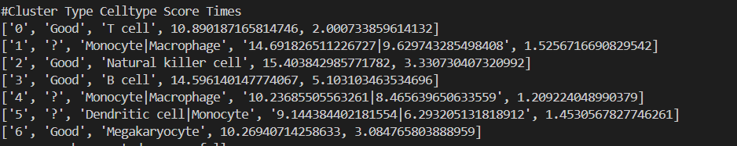
‘SCSA’ A Cell Type Annotation Tool for Single-Cell RNA-seq Data
Automated Annotation: SCSA automates cell type annotation in scRNA-seq data, integrating DEGs(Differentially Expressed Genes and marker confidence levels.
Score Model: SCSA employs a score annotation model, standardizing marker gene comparisons for unbiased annotation.
Notes:
Score Annotation Model: SCSA constructs a score annotation model that accounts for quantitative information and discrepancies among marker genes. It creates a cell-gene sparse matrix based on DEGs and known marker databases, generating raw score vectors for each cell type. By performing z-score normalization, SCSA standardizes these vectors for comparison, ensuring unbiased and precise cell type annotation across different datasets and experimental conditions.
Automated Cell Type Annotation: SCSA provides an automated solution for annotating cell types in single-cell RNA sequencing (scRNA-seq) data, eliminating the need for manual annotation strategies. It combines differentially expressed genes (DEGs) with confidence levels of cell markers from known and user-defined information to assign cell types accurately and efficiently.

Slide 15
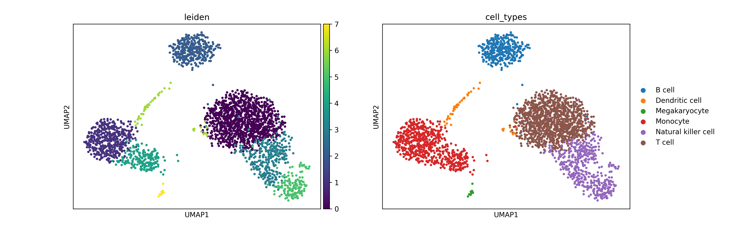
Annotation and Saving Result
Annotated cell types based on the SCSA results
Saved the processed data and analysis results for further downstream analysis and interpretation.

Slide 16
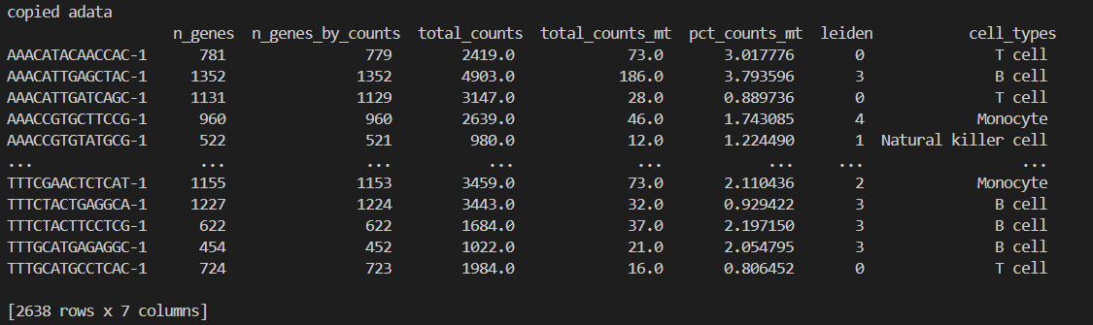
Data After Annotation

Slide 17
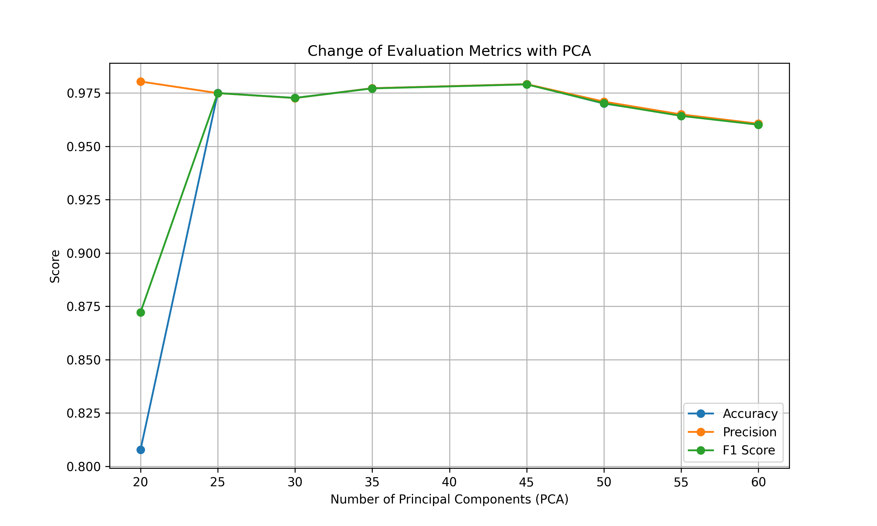
Result and Analysis
Evaluated and Plotted evaluation metrics against the number of principal components to optimize parameter settings.

Slide 18
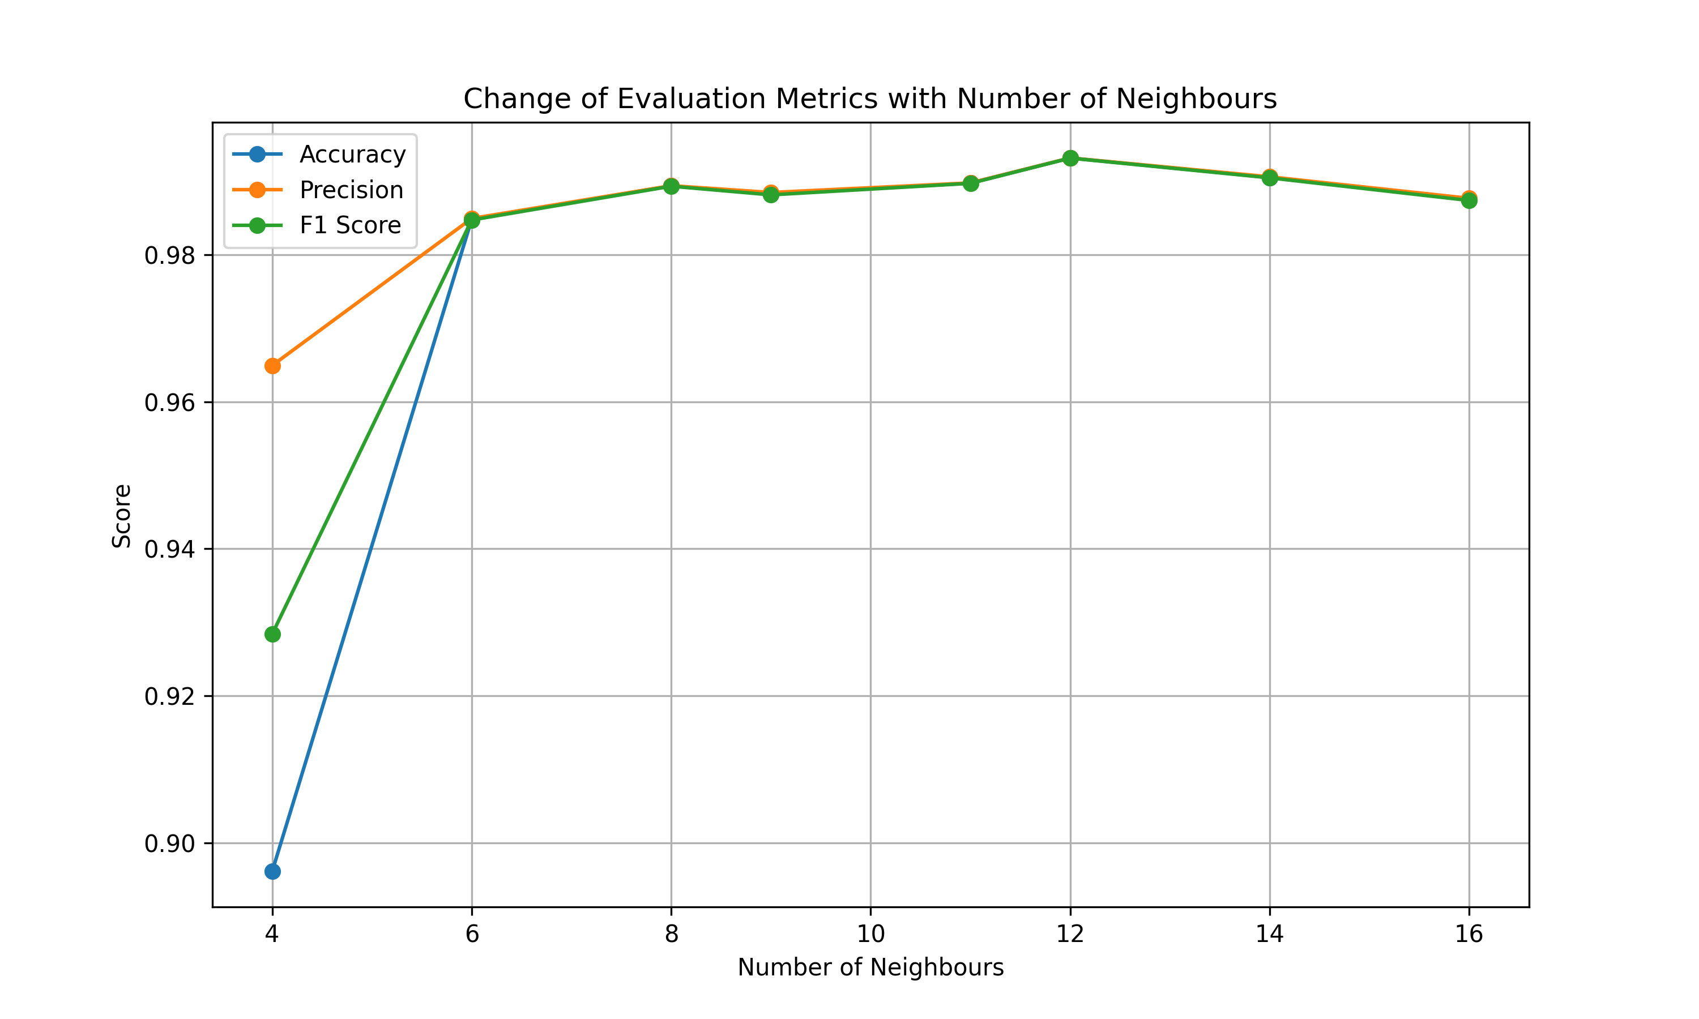
Result and Analysis
Evaluated and Plotted evaluation metrics against the number of neighbours to optimize parameter settings.

Slide 19
Analysis
The results show that as we move further away from the standard Hyperparameter used by Scanpy(PCA 40, Neighbours 10), the results deteriorate.

Slide 20
Future Goals
Working with different datasets to compare the results
Finding and applying non cluster-based cell type annotation tools to compare the results with SCSA annotation.
Showing a comprehensive summary of all the results
Finding proper Biologically meaningful annotations to use as ground truth to calculate different evaluation metric.

Slide 21

Thank you
Ismam Hussain Khan | Friedrich Alexander University |

